Slide 1

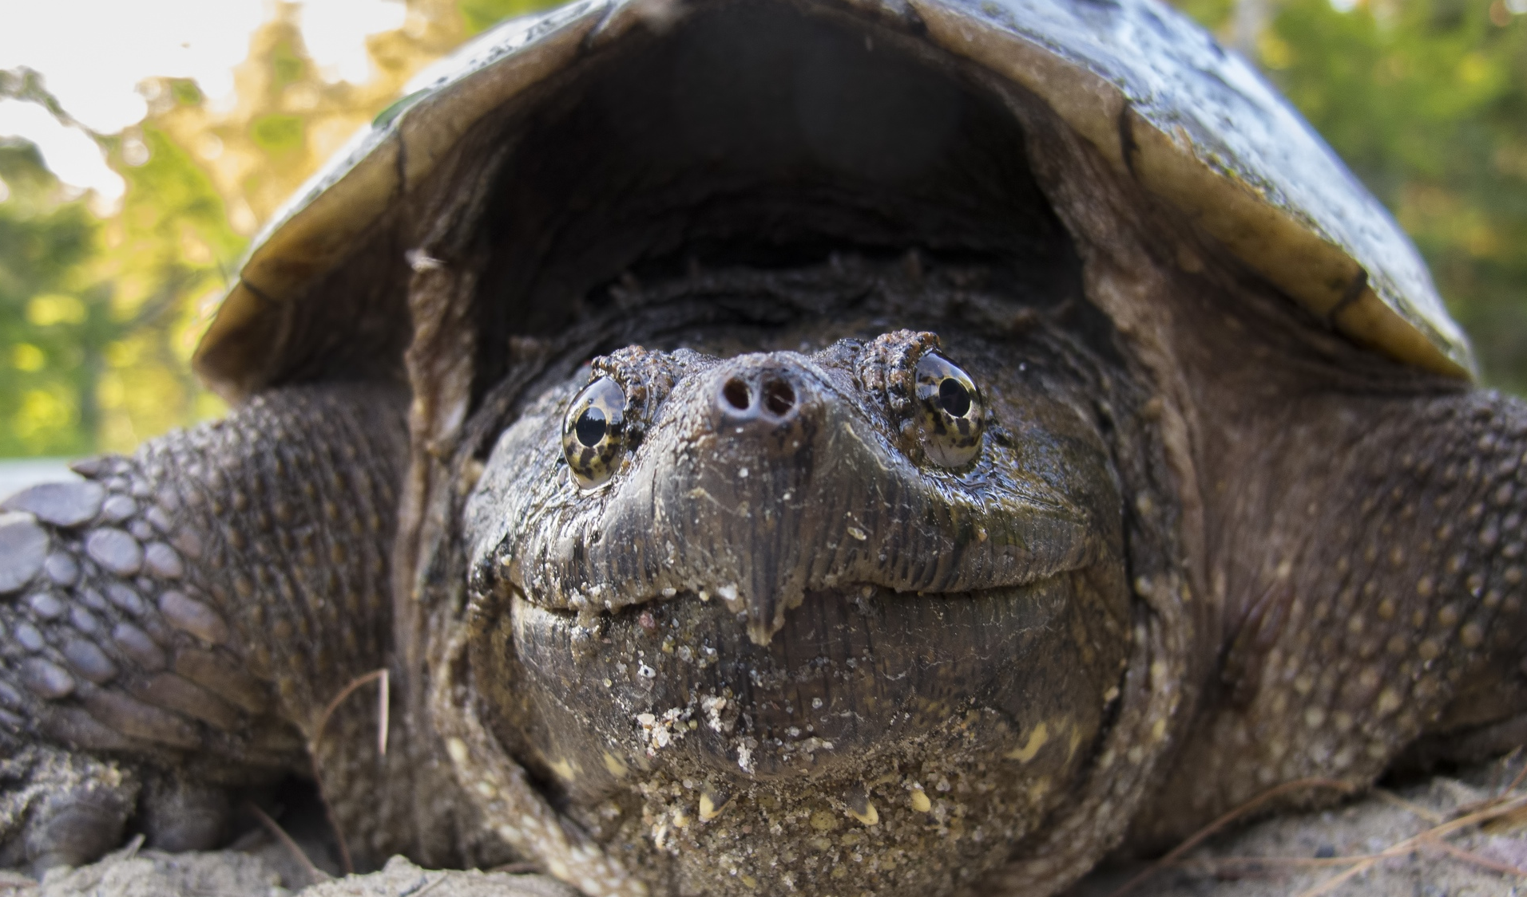
The Common Snapping Turtle
(Chelydra serpentina)
Notes:
Check this website out for conservation activities https://incredibleworld.ca/lessons-new/
Activity idea:
Use quarters to represent snapping hatchlings (about this size in real life). 3 brown pieces of paper on table. About 25 quarters on each paper representing possible hatchlings. Then complete presentation, and at the end cover 2 of the nests (about 70% nest predation rate Congdon et al. 1987, but this really varies on year and location. Regardless, this number is very high). Really drive home that visual, that snapping turtles need our help. They are designed to survive with this level of natural predation, but any more (from HUMANS) really puts their numbers at a decline☹
Congdon, J., Breitenbach, G., Richard C. van Loben Sels, & Tinkle, D. (1987). Reproduction and Nesting Ecology of Snapping Turtles (Chelydra serpentina) in Southeastern Michigan. Herpetologica, 43(1), 39-54. Retrieved December 16, 2020, from http://www.jstor.org/stable/3892436

Slide 2
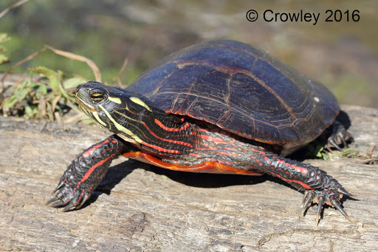
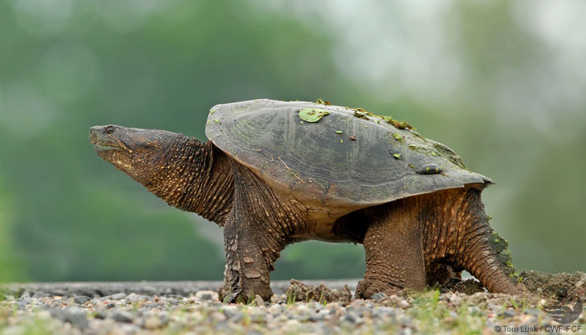
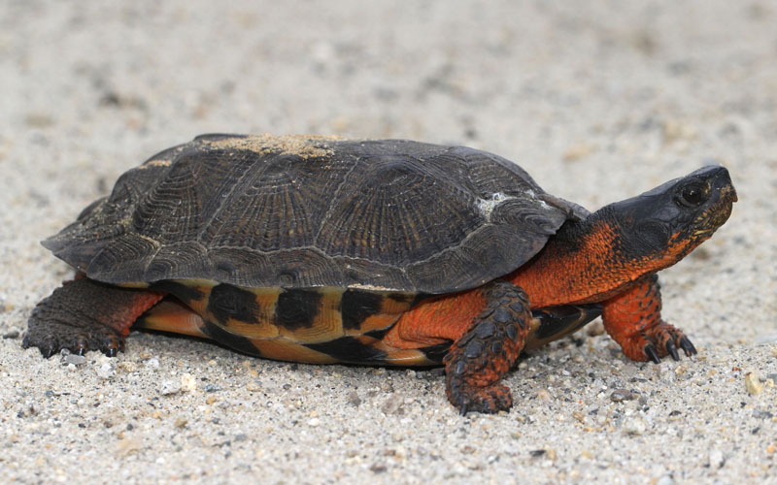
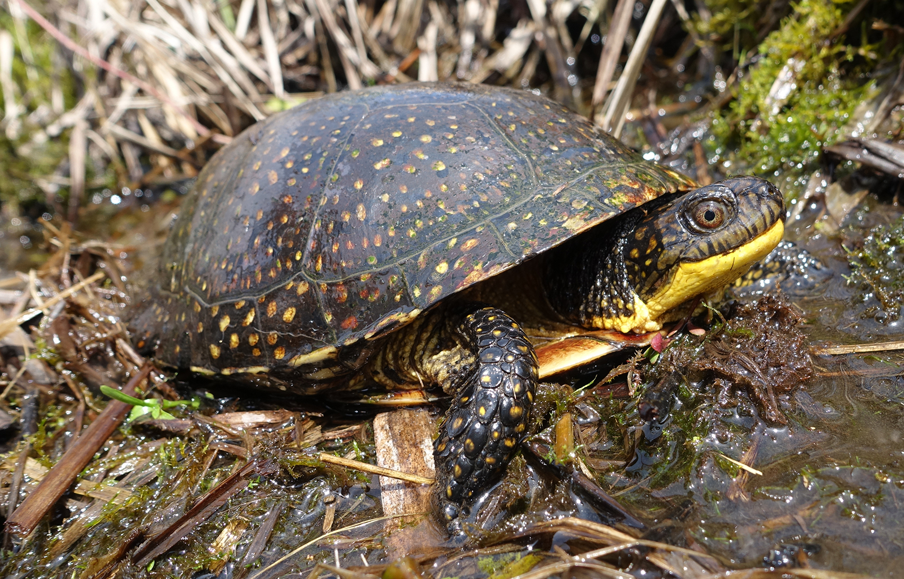

Which one is the Snapping Turtle?
(Photo: Mary Holland)
(Photo: Scott D. Gillingwater)
Notes:
Quiz:
Ask what number is the snapping turtle.
Bonus points -> can you name/identify the other three species? 1) Eastern painted turtle 2) Snapping turtle 3) Wood turtle 4) Blandings turtle
One of the largest freshwater turtles in Canada, the snapping turtle has an earthy coloured shell and hooked upper jaw. Spiky scales on its tail give it a prehistoric appearance.
https://naturalhistory.novascotia.ca/resources/reptiles-and-amphibians-nova-scotia/nova-scotia-turtles (Can use as reference)

Slide 3
https://www.natureconservancy.ca/en/what-we-do/resource-centre/featured-species/reptiles-and-amphibians/snapping-turtle.html
Notes:
Snapping turtle range in Canada. 6 provinces: Saskatchewan, Manitoba, Ontario, Quebec, New Brunswick, Nova Scotia
Ask the kids where we live on the map (point out Nova Scotia)

Slide 4
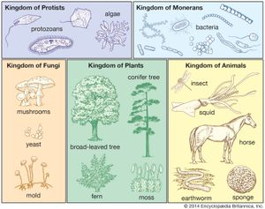

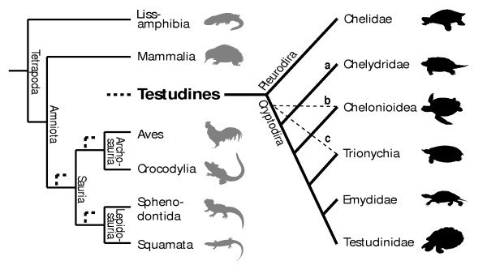
Scientific Classification
https://www.britannica.com/science/taxonomy/Making-a-classification#/media/1/584695/107934
Domain: Eukarya
Kingdom: Animalia
Phylum: Chordata
Class: Reptilia
Order: Testudinidae
Sub Order: Cryptodira
Family: Chelydridae
Genus: Chelydra
Species: C. serpentina
https://www.britannica.com/science/taxonomy/Making-a-classification#/media/1/584695/107934
https://www.britannica.com/science/taxonomy/Making-a-classification#/media/1/584695/107934
Werneburg and Sánchez-Villagra (2009)
Notes:
https://naturalhistory.novascotia.ca/resources/reptiles-and-amphibians-nova-scotia/nova-scotia-turtles
Info ref for presentation: https://en.wikipedia.org/wiki/Turtle

Slide 5
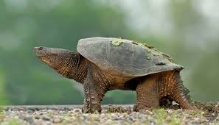

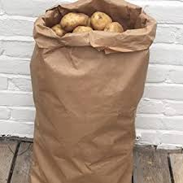
Why “snappers”?
PROTECTION.
Cannot fit inside of their shells.
How big are they?
Up to ~47 cm/18.5 inches in length.
20 kg/45 pounds (a large bag of potatoes).
(Photo: Canadian Wildlife Federation)
Notes:
SO why are they called Snappers? They snap with their strong jaws because that is the only form of protection they have. Not mean, just scared.
Length: can be as along as a ruler and a half.
And at their biggest can weigh as much as a large sac of potatoes (give a visual to how big they can be)

Slide 6
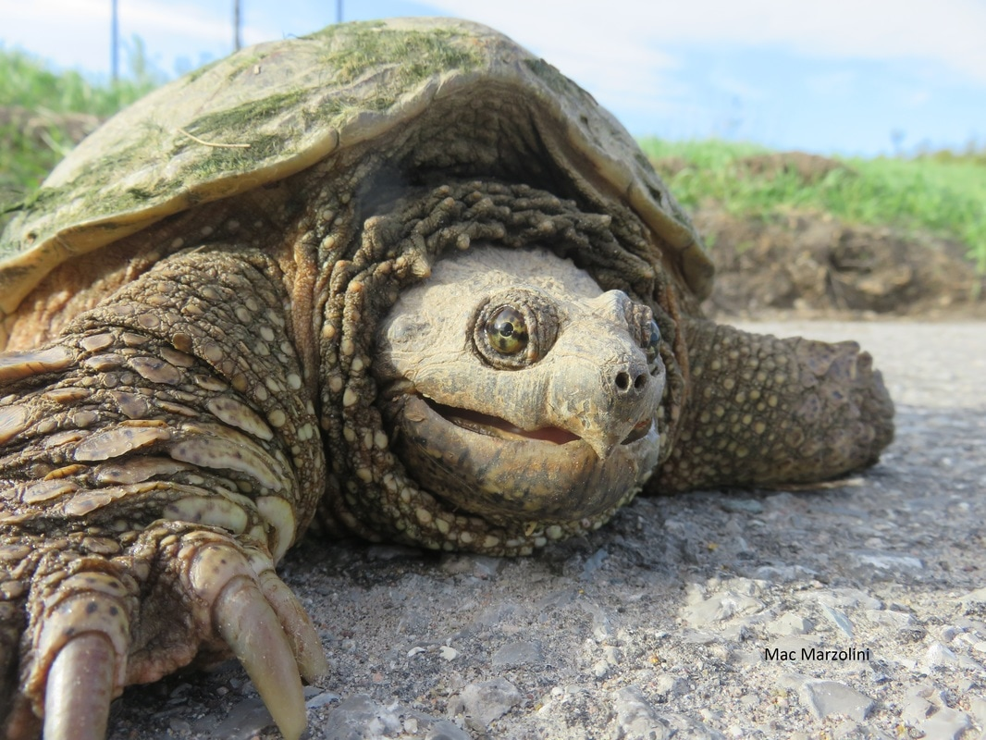
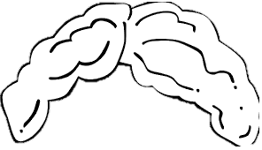
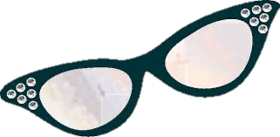
Why Are Snappers ‘Vulnerable’?
Mature very slowly.
17-19 years old before they start laying eggs.
Must lay 1,400 eggs in her lifetime for ONE offspring to survive.
The loss of even a few adult turtles from a population every year is enough to cause that population to decline.
Notes:
Snapping turtles are listed at VULNERABLE in Nova Scotia. Why? They can survive up to 70 years (high end record), but more likely will live to around 50 years. Start laying eggs at 17-19. Almost halfway through their life before they start reproducing.
(From https://view.publitas.com/on-nature/the-road-to-extinction/page/5 : snapping turtles mature very slowly. Females do not start to lay eggs until they are between 17 and 19 years old. Once an egg is laid, the probability that the offspring will survive to adulthood is very small. On average, a female snapping turtle would have to lay about 1,400 eggs during her lifetime in order for ONE of her offspring to survive to adulthood. In other words, a female snapping turtle that lays an average of 34 eggs per year would need to survive 58 to 60 years to replace herself in the population with another adult snapping turtle.)
Other animals, like a female white-tailed deer, which only matures at two years of age, can replace herself in only four years.

Slide 7

Where Do Snappers Live?
Slow-moving water with a soft mud bottom and lots of aquatic plants.
Ponds, marshes, swamps, river/lake edges, slow-moving streams.
Even golf course ponds!
Notes:
Individual turtles – survive in highly polluted water like golf course ponds that may not be able to sustain an entire population.

Slide 8

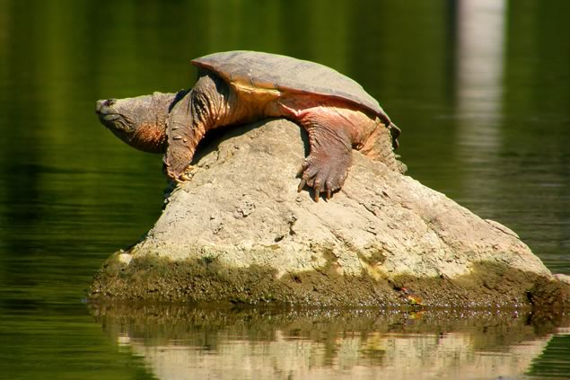
How Do Snappers Stay Warm?
Ectotherms – get heat from their environment.
Basking in the sun!
Surface of water, shallow water, logs, rocks, stream banks.
Stop moving when the water temperature drops below 5°C.
Photo: In The Hills: Friends of Ontario Snapping Turtles
Notes:
We are ectotherms! We maintain a steady internal temperature.

Slide 9
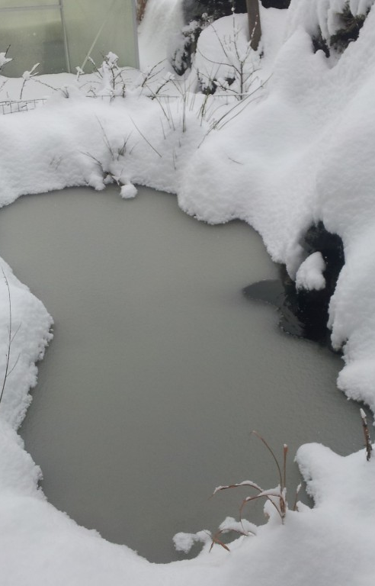
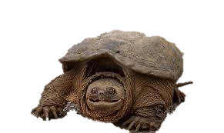
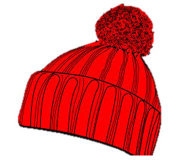
Where Do Snappers Go in the Winter?
Hibernation!
Must avoid freezing in the winter.
Water shallow enough to reach surface to breathe, but deep enough so water will not freeze to the bottom.
Notes:
You may think of bears when you think of hibernation, but turtles hibernate too!
In the winter snapping turtles hibernate in shallow water, buried in the mud in places which do not freeze to the bottom, usually in groups
During this time they hardly move, although some have been observed moving under the ice
Sometimes travel long distances until they reach suitable places to hibernate

Slide 10
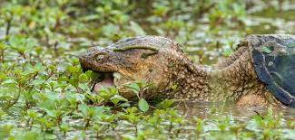
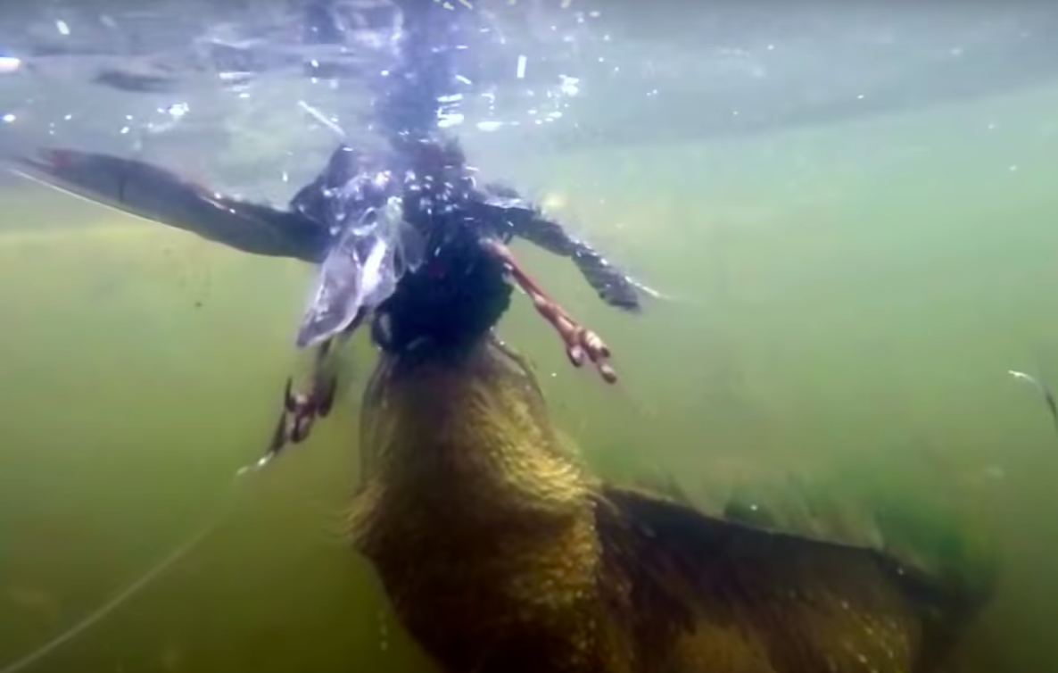
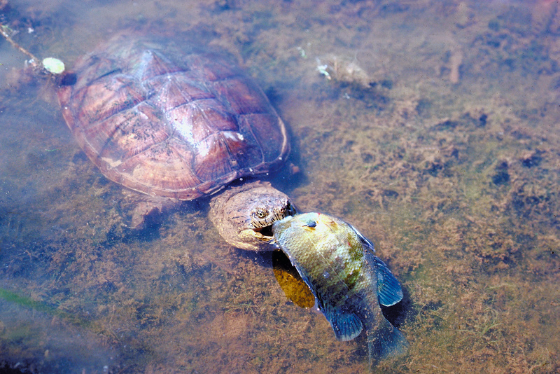
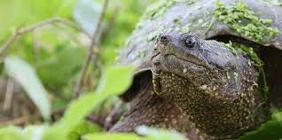
What Do Snappers Eat?
Omnivore
Algae
Fruits, leaves, stems
Snails
Insects
Fish
Salamanders
Small turtles, snakes
Birds
Small mammals
Forage, scavenge, ambush prey
Live prey, carrion
Notes:
More plants than animals, but they are omnivores.

Slide 11
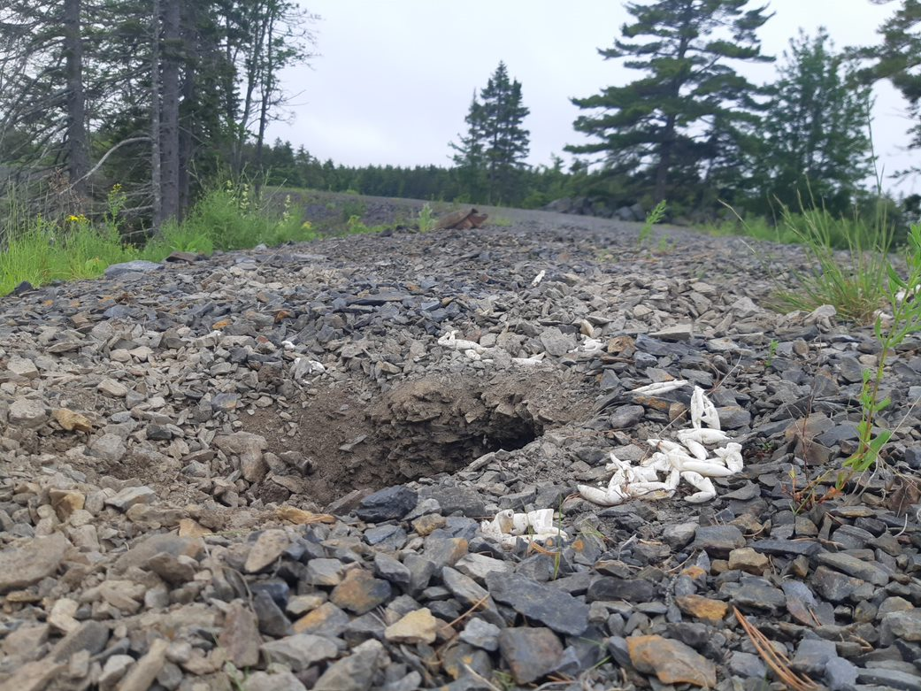
Who Eats Snappers?
Raccoons
Striped skunks
Red foxes
Opossums
Coyotes
Humans
Notes:
Snappers eat, as well as are eaten by other animals. Full grown snappers have no natural predators. But baby hatchlings and eggs are very vulnerable to the animals on the slide.

Slide 12
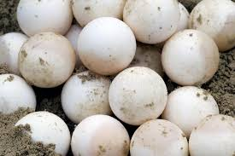
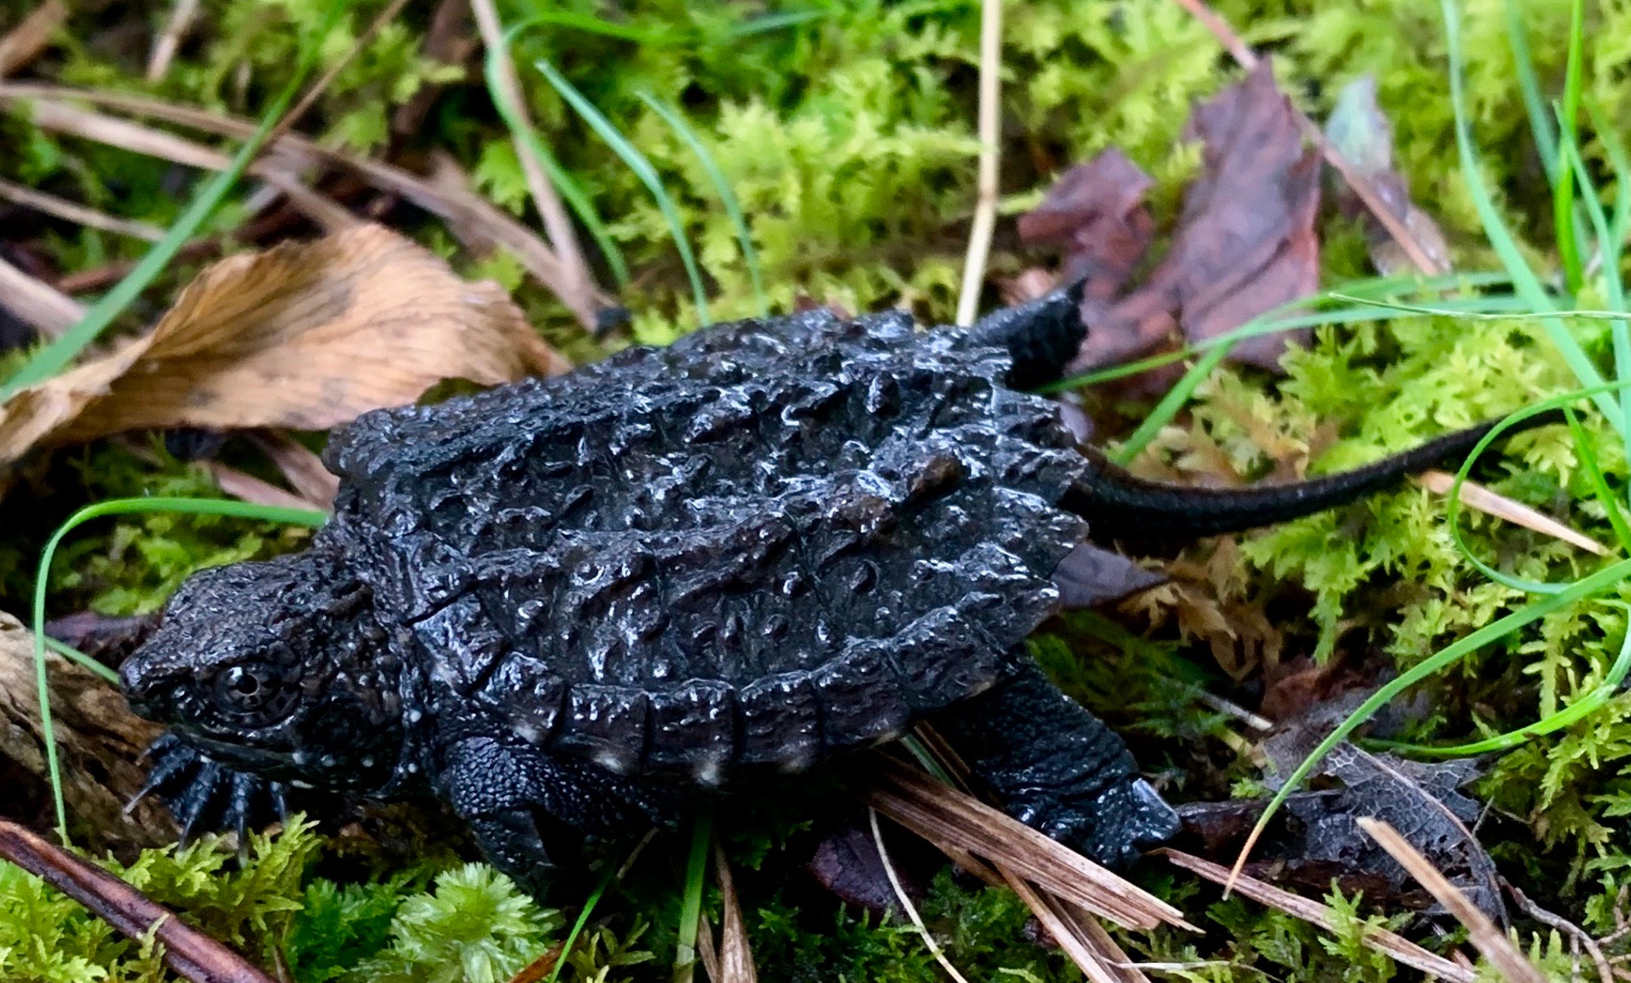
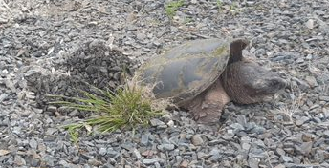
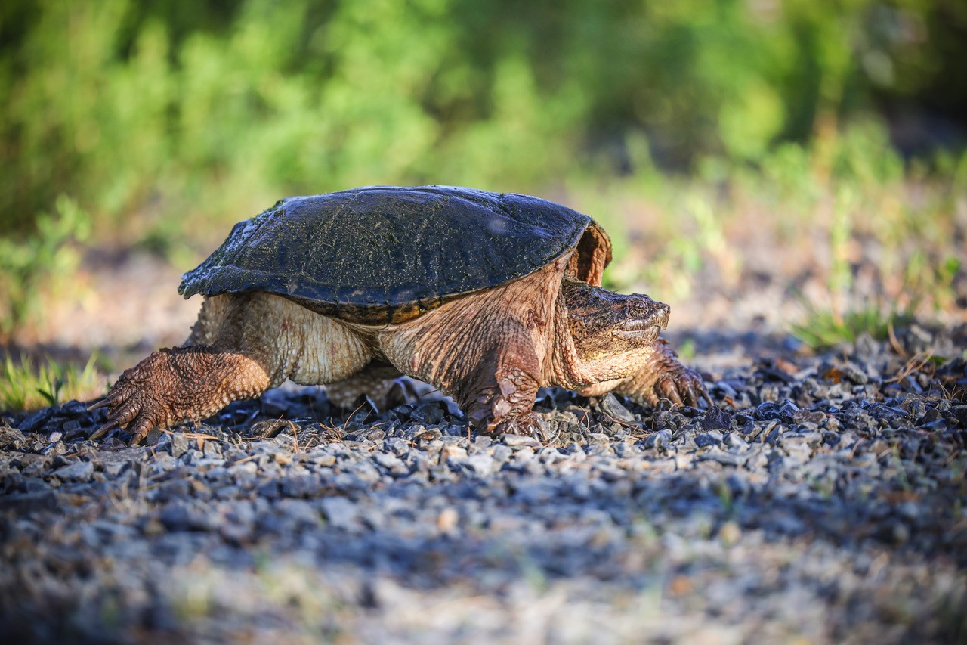
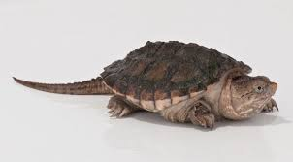
In the Life of a Snapper
Egg
Hatchling
Juvenile
Adult
Nesting
Noah Hardy
Notes:
Snappers go through a life cycle, just like you!
Hatchlings are the size of a quarter when they emerge from their eggs!
Eggs are usually laid around mid June, and hatch around September (90-120 days).
In general, larger turtles are older than smaller turtles. It can take almost 20 years for a turtle to get to the adult stage and be ready to lay eggs.
See ridges on hatchling and slightly on juvenile? These smooth out and flatten when the turtle becomes an adult.
https://northernwoodlands.org/outside_story/article/life-snapping-turtle

Slide 13
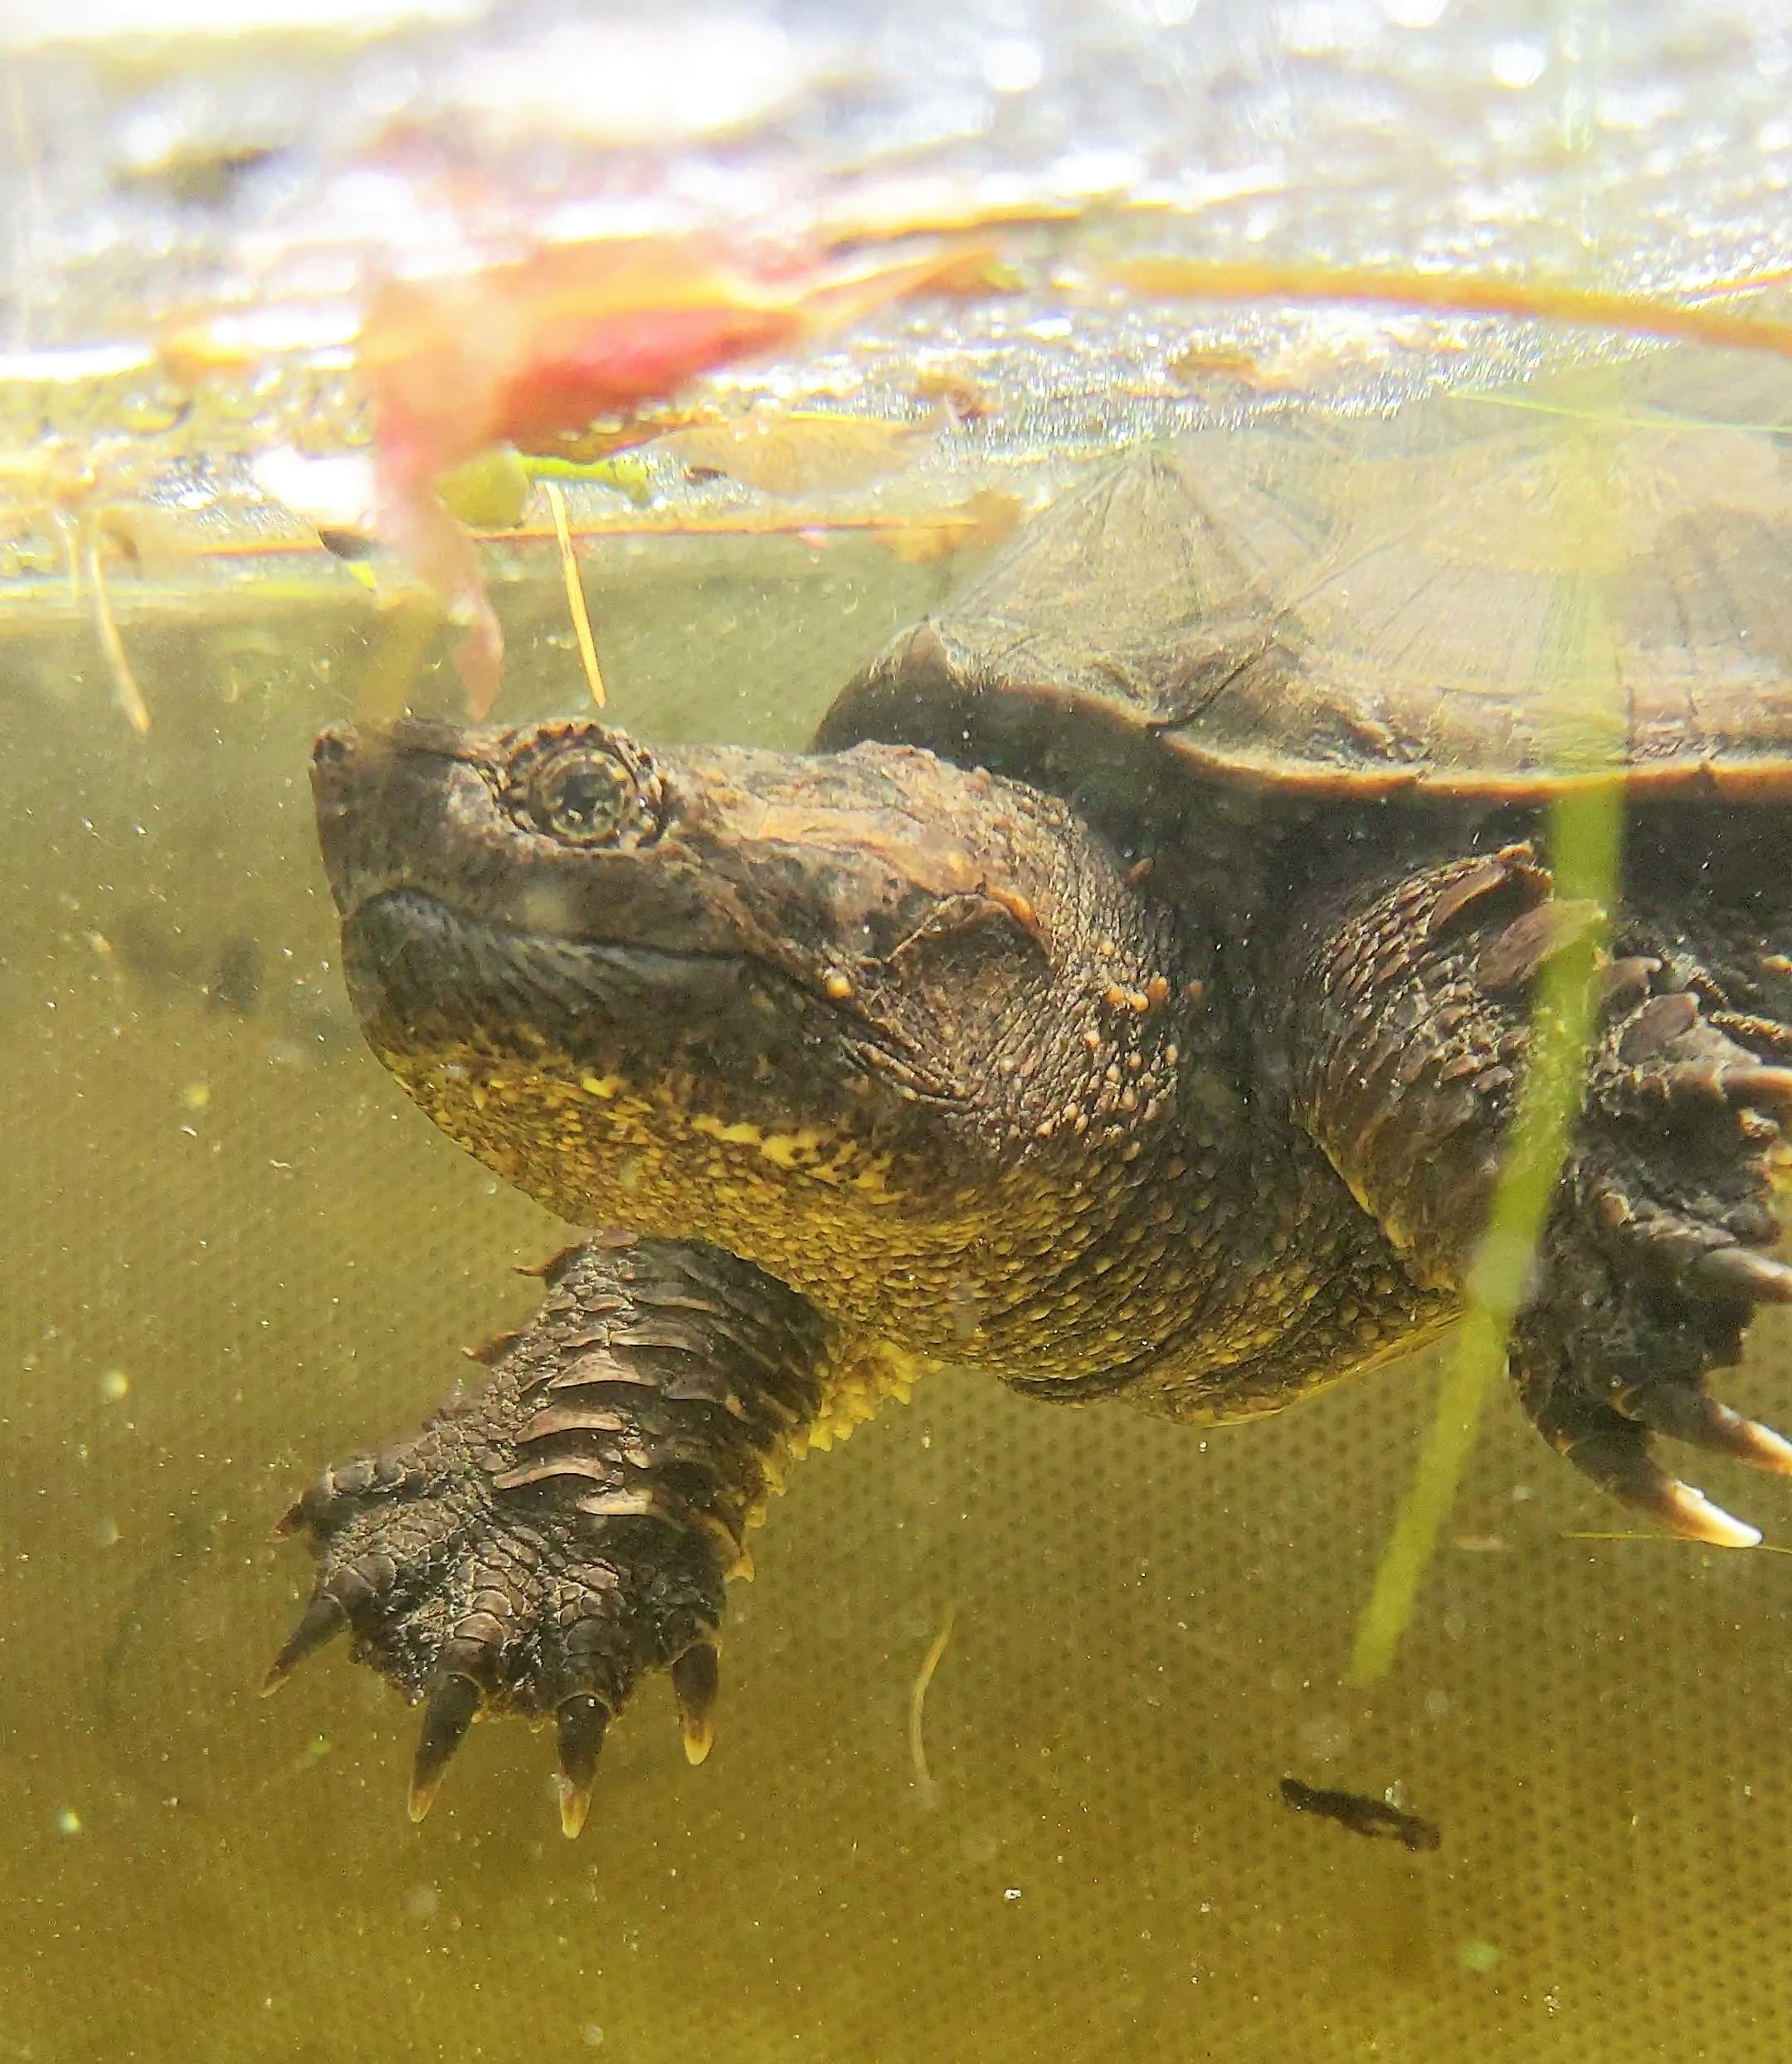

Why Do We Need Turtles?
Cultural significance to the Mi'kmaq of Nova Scotia
Scavengers, cleaning up dead organisms from waterbodies.
Large % of their diet: dead animal and plant matter.
Eat dead plants, releasing CO₂
Keep lakes and wetlands clean!
Turtle eggs are food for skunk, fox, raccoon, mink.
Notes:
You can think of snapping turtles as mini dumps trucks that go around an ecosystem, cleaning up/eating all the stuff that no one wants anymore.

Slide 14
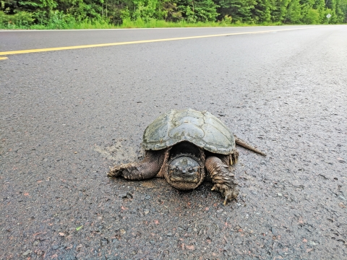
Threats to Turtles
Road Mortality
What to do if you see
a turtle on the road:
Tell parent/guardian to only pull over if it is safe for you to do so.
Help it across in the direction it was moving.
Do not stop your car on a busy road to move a turtle.
Do not place your hands on the turtles’ sides or lift it by the tail.
Can get bitten and/or injure the turtle.
Be careful, snappers have long necks and can bite!
Common snapping turtle on road, Courtney Celley/USFWS, Public Domain, https://www.fws.gov/media/common-snapping-turtle-road
Notes:
What to do if you see a turtle on the road:
Only pull over if it is safe for you to do so.
Help it across in the direction it was moving.
Do not stop your car on a busy road to move a turtle.
Can *carefully* use a shovel or car mat to help move it across.
Can pick up the back half of the shell and push gently like a wheelbarrow.
OR can place one hand on back of shell and one hand underneath on stomach to stabilize.
FOR THE SAFETY OF THE TURTLE AND YOURSELF:
Do not place your hands on the turtles’ sides or lift it by the tail → Can get bitten or injure the turtle.
Do not push a turtle across with your feet or stick → Underbellies on rough pavement = Ouch.
Protecting and Conserving Wood Turtles: A Stewardship Plan for Nova Scotia, Biodiversity Program, Wildlife Division Nova Scotia Department of Natural Resources, 2003

Slide 15

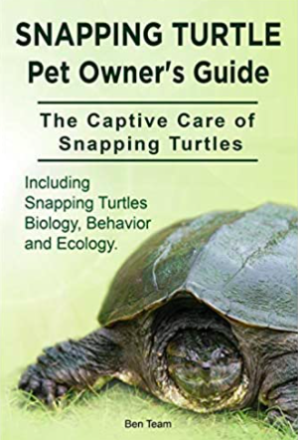
Threats to Turtles
Persecution
Reputation as an aggressive animal.
Really just protecting themselves.
Target of illegal acts of abuse.
People sometimes hurt snapping turtles on purpose because of their bad reputation.
Legal and illegal harvesting
For medicine or decorative (trinkets).
Adults caught for food, juveniles and hatchlings as pets.
Notes:
This goes for all wild turtles. They are not pets!

Slide 16


Threats to Turtles
Habitat Loss
Water pollution, such as agricultural runoff, is a major threat as polluted water bodies cannot sustain a significant snapping turtle population
Turtles are threatened when habitats such as wetlands, streams, and nesting sites are altered or lost to urban and agricultural development

Slide 17
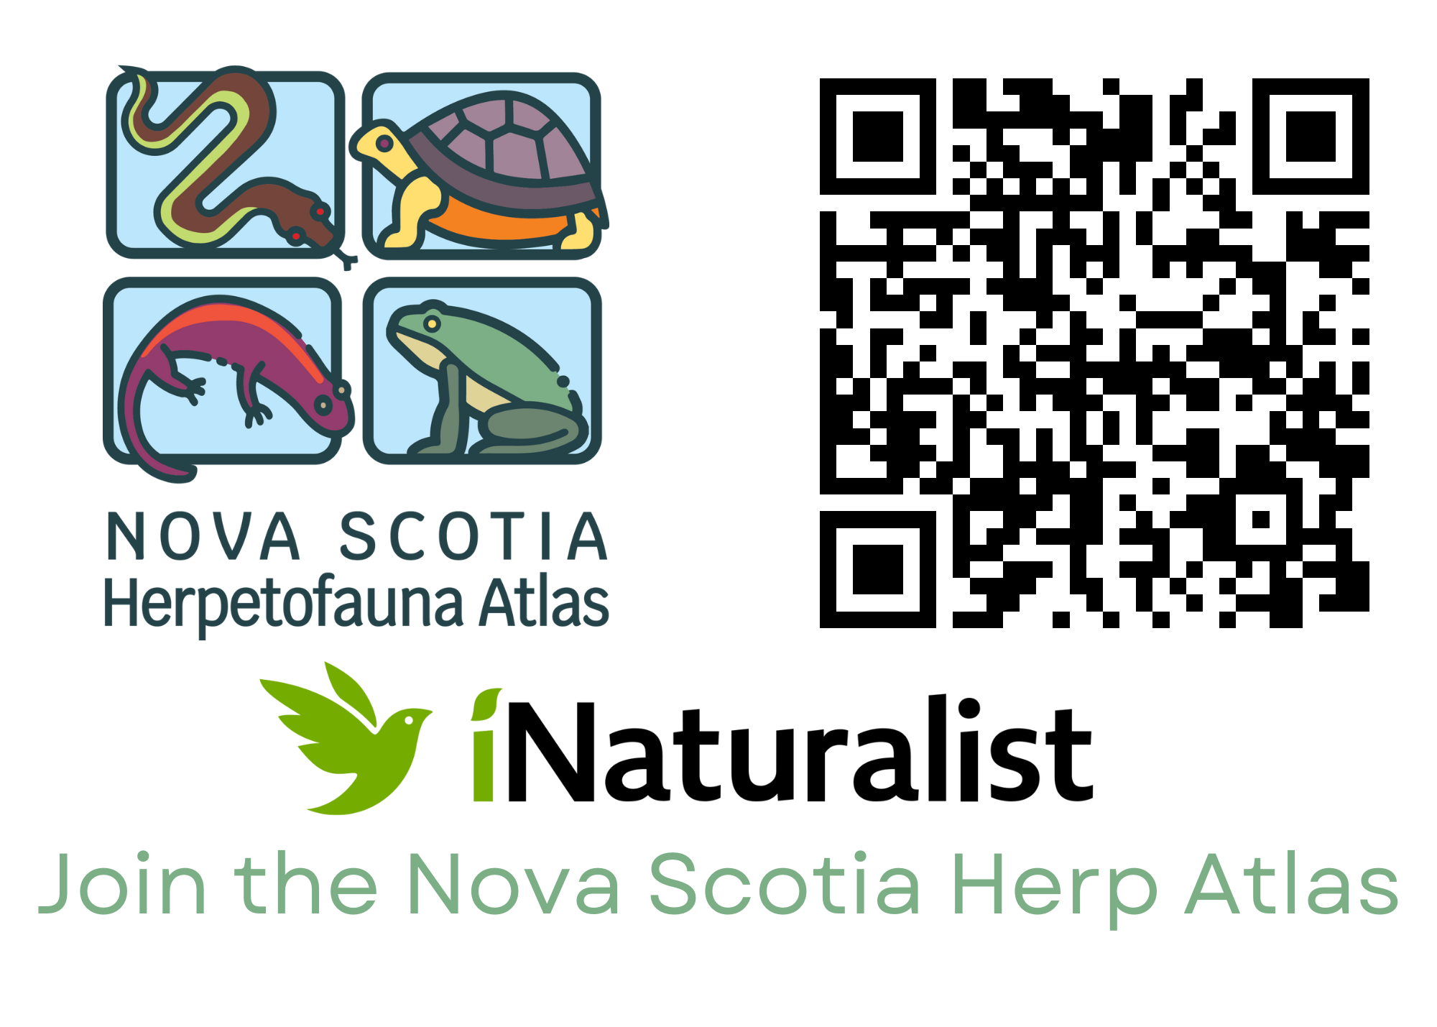
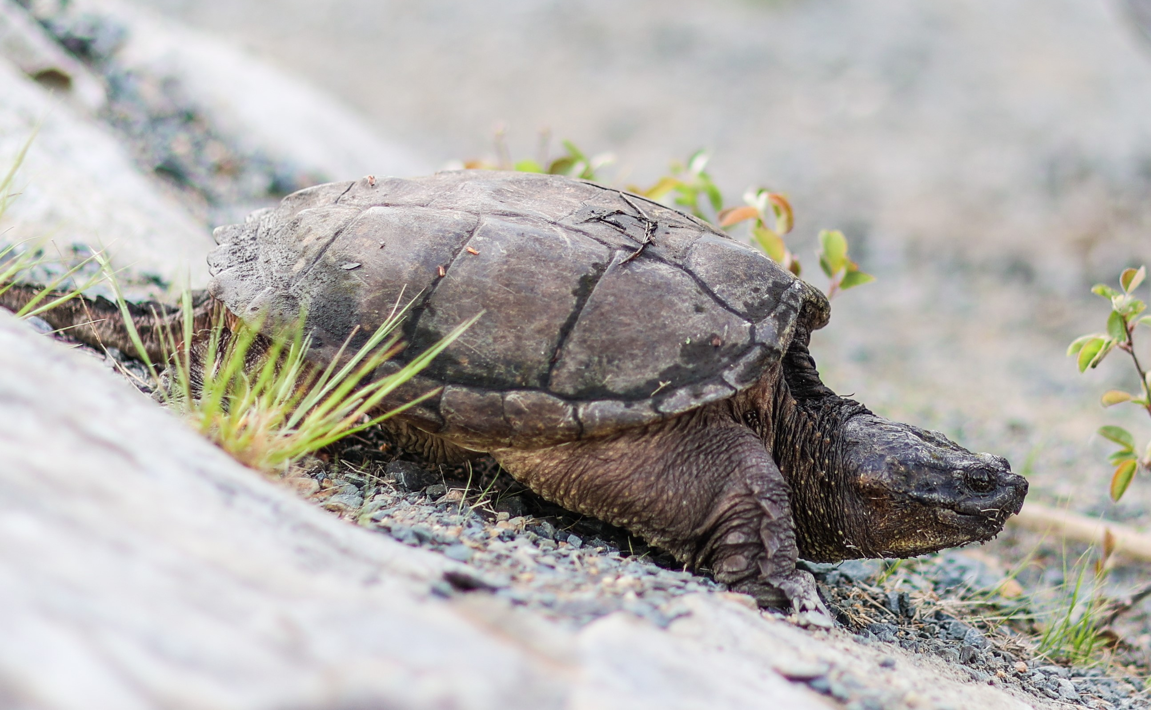
If You See A Snapping Turtle
Avoid touching, moving, or getting too close. Admire from a distance!
Report any sightings of Blanding's, Wood, or Snapping turtles to:
biodiversity@novascotia.ca
Nova Scotia Herp Atlas (see link above)
Notes:
AVOID touching Snapping turtles or getting too close – you will scare them (you’re so much bigger than it).
Yes, they are super cool, dinosaur looking creatures, but for your safety, and theirs, leave them alone. Use zoom feature on a phone or camera to get a better look while keeping your distance.
(Take home message: Leave the turtles BE)
Activities: Can lead a iNAT Project – observations throughout the year

Slide 18
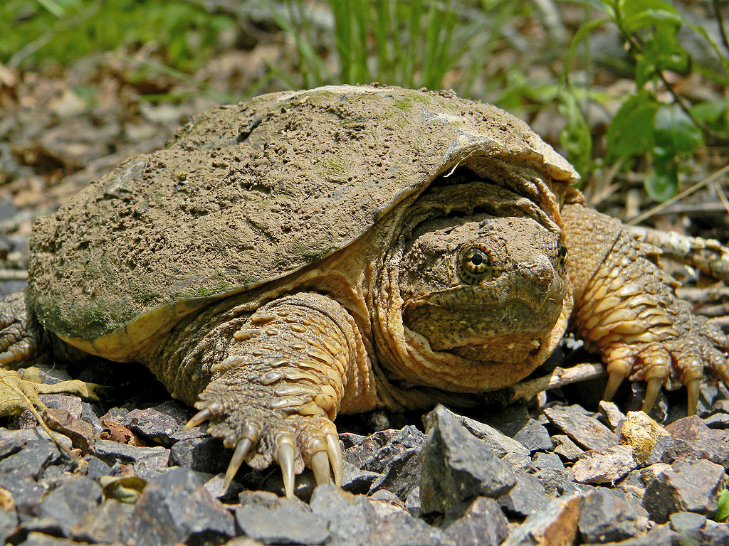
Questions?
Thank you!
Photo: Wiki Commons
Notes:
Coastal Action is more than happy to engage and respond to questions regarding Snapping turtles, but also many at risk species. Feel free to contact.

